Slide 1

How to Have Meaningful Conversations
By: Sarah Rozenthuler

Slide 2
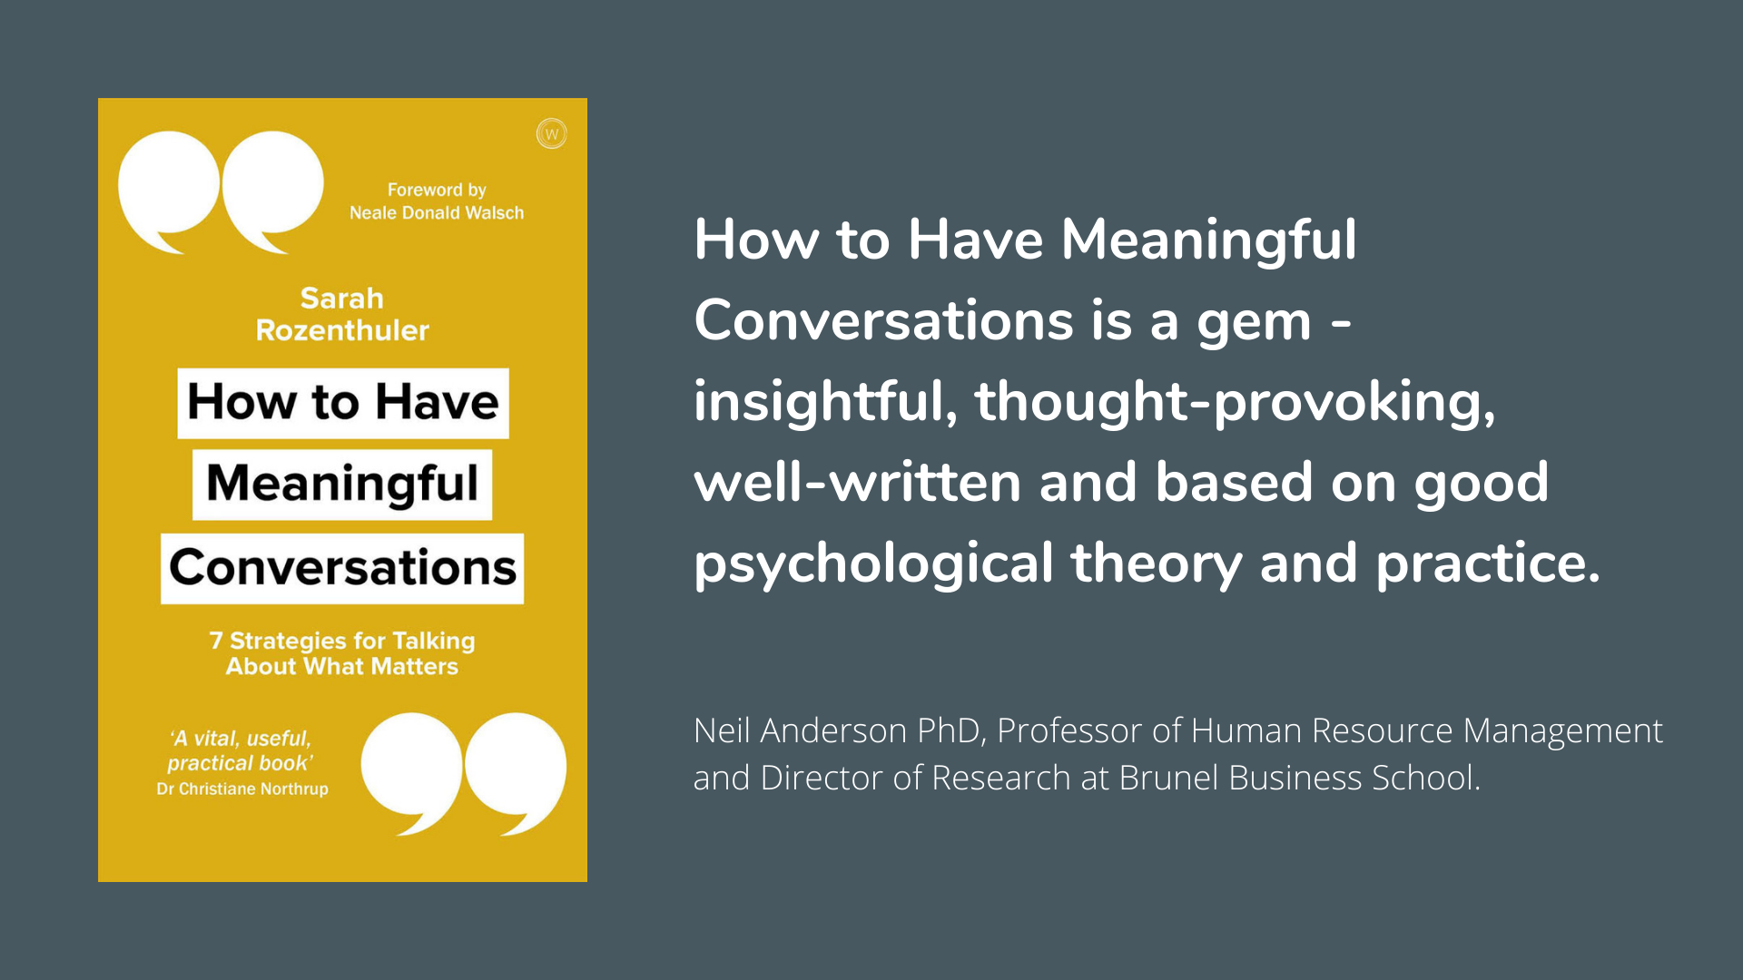
“How to Have Meaningful Conversations”
Meaningful conversation is the single most effective way to bring about real change and growth in your life. This book expresses key tools on how to facilitate these conversations.
Each of the 7 chapters guides readers through a 7-point plan to help grow in confidence and achieve lasting results.

Slide 3
Tip #1
Call up your courage - to right a wrong, be bold, don't avoid tough subjects
American Behavioral Scientists (February, 2004) published a compelling piece of research that observed the conversations of 60 management teams, each team about 8 members.
The researchers found that high-performing teams talked together in ways that were distinct from low-performing teams…
Asked questions as often as they asserted their own opinions (a 1:1 ratio between enquiry and advocacy)
Showed as much interest in others as they did themselves (a 1:1 ratio between focus on self and on others)
Made more positive than negative comments (a 3:1 ratio of positivity to negativity)
Notes:
page 19

Slide 4
Tip #2
Create a Container - to renew a relationship, talk about what's been lost/forgotten
Careers have been languished, marriages have dwindled and friendships have withered all because of our inability to talk
It’s Harder to Build Trust - with electronic communication we don’t have the social cues that we rely on to decode messages. Without face-to-face communication, we miss the resonance of the person’s tone of voice
People are Less Likely to be Honest - when we can hide behind an email or text, it becomes more tempting to lie.
It’s Easier to Disagree - because the communication happens at a distance, we can disconnect more easily.
Misunderstandings are more likely - because there’s usually a delay between a message being sent and reply being received, it’s harder to create a flow in the communication.
Notes:
page 32

Slide 5
Tip #3
Intend the Message You Send - talk about what you really want
There are 7 thought patterns that cause barriers to a conversation.
Inhibitor 1 - “I can’t talk about it”
We don’t know how the other person will respond, how talking will impact our relationship and how our life will change as a result
Inhibitor 2 - “I don’t know how to reach out”
Thinking that we don’t have the resources to handle the conversation, we turn away from talking
Inhibitor 3 - “I can’t decide what to do”
We’re not clear exactly what to say, we tell ourselves it’s better not to say anything
Inhibitor 4 - “I don’t want to hurt their feelings”
Sometimes our truth changes and we think we’ll betray someone if we voice how we now feel
Inhibitor 5 - “I don’t know what to say”
Sensing that we might be judged and found unworthy, we go silent
Inhibitor 6 - “I’m right, you’re wrong”
We’re sometimes willing to end a relationship, walk out of a job, or damage our health all because we want to feel that we’re right
Inhibitor 7 - “It’s too hard to talk about it”
When we think that there’s a battle ahead, we stiffen up and the atmosphere becomes taut
Notes:
page 41

Slide 6
Tip #4
Connect with Respect - voice your deepest desires and honor the other person
There are 4 basic actions that can be made in any conversation. Each action brings a different intention and a distinct quality to how we talk together:
A “move” brings direction - by saying, for example, “I suggest we talk about…”, “I think we should decide to…”, “My proposal is that we…”
A “follow” brings completion - by saying, for example, “I agree that…”, “I support the suggestion to…”, “Let’s do as you say and…”
An “oppose” brings correction - by saying, for example, “I disagree with…”, “I see things differently in that…”, “My challenge to that is…”
A “bystand” brings perspective - by saying, for example, “I’m noticing that…”, “It seems there is a dilemma here…”, “What I’m observing is that…”
Notes:
page 102

Slide 7
Tip #5
Speak your truth - say "hard truths”
Remember to express yourself OFT’N
O is for Observation – Focus on the facts. Leave to one side your judgements, opinions, and assertions
F is for Feeling – Express your happiness, sadness, anger, envy, shame, fear or other emotion using simile “I” statements
T is for Thinking – Speak of “what’s working” and “what’s not working”
N is for Needs – Request what you need. Take responsibility for what you want to be different
Notes:
page 148

Slide 8
Tip #6
Surrender your story - talk about possibilities
The following steps will help you surrender your story…
Marshal your resources - make the most of any external sources of support that will help you to prepare for the conversation
Look for the light - leverage inner resources, such as your optimism, sensitivity and resilience. Be clear what your natural strengths are
Change what’s changeable -pay attention to what you can change in your situation rather than what you can’t
Detach from the drama - write down a previous unsatisfactory conversation you’ve had, including your unexpressed thoughts and feelings
See your story - identify the troublesome emotions you experienced during an unsatisfactory conversation
Stop the sabotage - identify where in your inner dialogue you were blaming yourself
Speak the unspoken - notice the helpful, intuitive thoughts that bubble up inside during a conversation
Notes:
page 162

Slide 9
Tip #7
Find closure - make the conversation the tart of a new beginning
Positive emotions and behaviors help people and conversations to flourish
Feeling grateful, showing enthusiasm or saying what we like makes us happier; healthier and more resilient
Negativity in a conversation occurs when we get irritable, show contempt or express disdain
Negativity is also associated with taking more days off sick, worse physical health and poorer relationships
Research published by Barbara Fredrickson and Marcial Losada in the American Psychologist (2005) shows that the balance of positivity and negativity is crucial
In a healthy conversation, there are three or more positive statements for every negative expression. This 3:1 ratio reflects that “bad is stronger than “good”
When the toxicity of a negative statement is outnumbered by appreciative comments, it can change the conversation and change our life
Notes:
page 194

Slide 10
Thank You!
If you have any questions, feel free to reach out to me at katelyn.desautels@uconn.edu
Notes:
Additional Resources:
1) https://www.forbes.com/sites/johnhall/2013/08/18/13-simple-ways-you-can-have-more-meaningful-conversations/?sh=564bcf224fe9
2) https://www.linkedin.com/pulse/interviews-leading-meaningful-conversations-ritu-bana/

